Slide 1
Children and Young People Programme
Highland Self Management Forum
Thursday 7th September 2023

Slide 2
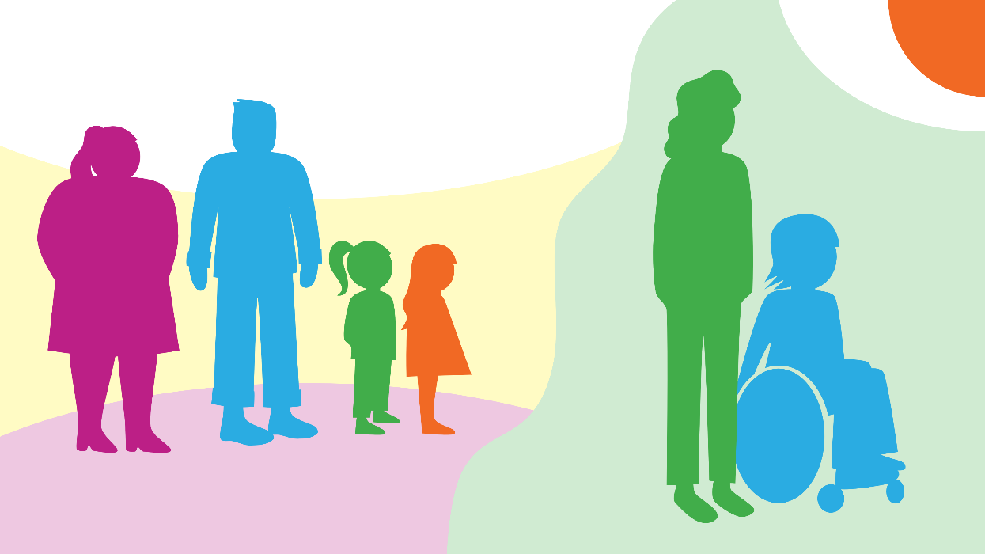
Children and Young People Programme
The programme aims to raise awareness of ongoing developments in the children’s policy agenda in Scotland, and specifically matters that have an impact on disabled children and young people’s lives, those living with long term conditions, and their families and carers.

Slide 3
Children and Young People Programme
Transitions into Adulthood Strategy to support disabled children and young people
Incorporation of the UNCRC
Child Poverty/Cost of Living
National Care Service
Engagement with children and young people

Slide 4
GIRFEC
GIRFEC is the Scottish Government’s commitment to provide all children, young people and their families with the right support at the right time - so that every child and young person in Scotland can reach their full potential. It is the national approach to improving outcomes for our children and young people, bringing together and coordinating services so that children and young people get the help they need if or when they need it.

Slide 5
GIRFEC Values and Principles
Placing the child or young person and their family at the heart, and promoting choice, with full participation in decisions that affect them;
Working together with families to enable a rights-respecting, strengths-based, inclusive approach;
Understanding wellbeing as being about all areas of life including family, community and society;
Valuing difference and ensuring everyone is treated fairly;
Considering and addressing inequalities;
Providing support for children, young people and families when they need it, until things get better, to help them to reach their full potential; and
Everyone working together in local areas and across Scotland to improve outcomes for children, young people and their families.

Slide 6
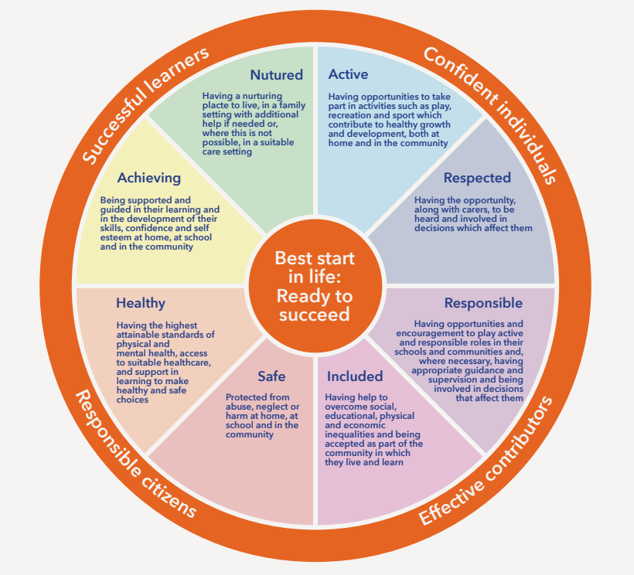

Slide 7
GIRFEC
Our project is aimed at raising awareness of how Getting it Right for Every Child (GIRFEC) can support disabled children and those living with long term conditions, their parents, and carers.
Training
GIRFEC Advisory Group
Scottish Government GIRFEC Team
Member contributions

Slide 8
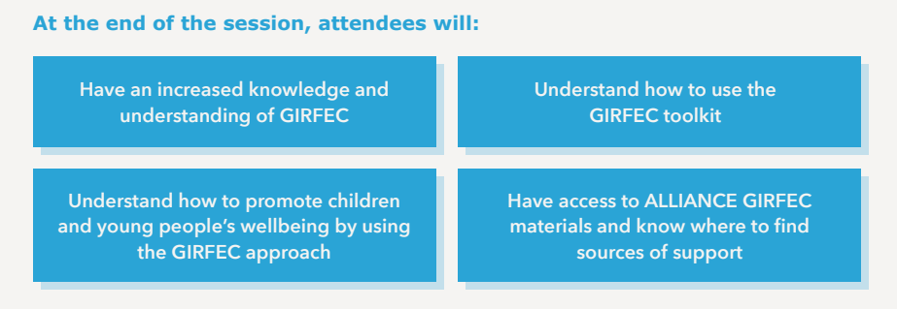
GIRFEC Training
Notes:
2 hour training session bespoke to organisations (minimum number of attendees is 10)
Open training sessions are held online every quarter open to individuals working across the third and statutory sector.
Train the Trainer sessions run bespoke for organisations wishing to cascade training to their own networks
Resources: The training is available on Youtube and split into seven modules. The training booklets are also available online to coincide with the training.
Pop-Up Sessions – offered to those who have received the training usually 2-3 months after training.

Slide 9
What are we hearing?
Increasingly shared language between families and professionals supported by the refresh
Lack of flexibility in the named person role
Positive relationships lead to better outcomes
Information Charters helpful but still some clarity needed
Wellbeing wheel helps plan for activities

Slide 10
Case Study Collection
We know individuals and organisations utilise GIRFEC in different ways. In addition to our training, we want to hear from people about their own experiences.
What does GIRFEC mean to you?
How do you use GIRFEC in practice?
How you have used GIRFEC which has led to positive outcomes?
Have you experienced challenges when implementing GIRFEC? How did you overcome this?
Email GIRFEC@alliance-Scotland.org.uk to find out more information

Slide 11
Community of Practice
The new Children and Young People, Community of Practice (CoP) has been created to provide a safe space for individuals working across the sector to come together to share promising practice, opportunities and learning and importantly to network with each other.
The CoP will be designed for and by its members with the ALLIANCE providing administrative support. At our launch event in June, members discussed the vision for the CoP. The below vision statement is in draft form and will be defined at future meetings:
“The Children and Young People Community of Practice is a safe space to bring together members; respecting individual views, values and ideas. A space to learn and connect with one another. The Community has shared ownership, with freedom to connect with one another. A social movement to help drive positive change.”

Slide 12
Get Involved
Open training session (external) Thursday 5th October 10am – 12pm Online
Children and Young People Community of Practice Wednesday 13th September 2pm – 4pm Online
Children and Young People Newsletter (Quarterly)

Slide 13
Any questions?
www.alliance-scotland.org.uk
GIRFEC@alliance-scotland.org.uk Marianne.Tyler@alliance-Scotland.org.uk
0141 404 0231

